Slide 1

Open Historical
Map

Slide 2

Freedom to add data
As long as it is verifiable on the ground
As long as it is somewhat permanent
As long as no copyright is infringed
Go add your specific needs!

Slide 3

How about historical data?
OpenStreetMap is not suited for
Demolished buildings
Historic borders (e.g. Roman Empire)
Removed data

Slide 4
What is
OpenHistoricalMap?

Slide 5
OpenHistoricalMap
A copy of the OpenStreetMap software
but with historical data

Slide 6
OpenHistoricalMap
The world's most universal, detailed, and out-of-date map

Slide 7
Works the same!
Well, nearly…
Additional start_date and end_data is highly recommended
A description can be added, eventually with
`description:1993`

Slide 8
Way less restrictive
OpenStreetMap is used every day by multiple users
  An error in the data has real life repercussions
  Data should be tagged correctly to be usable
  > 1 million different contributors

Slide 9
Way less restrictive
OpenHistoricalMap is a hobby project
Mostly intersting to historians
Little data already there
Feel free to import bigger datasets
<1000 contributors

Slide 10
License...
Data you add should be considered CC0 (public domain)
Data you use should be considered OdbL

Slide 11
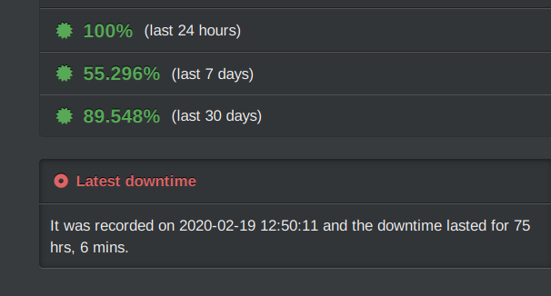
Uptime...

Slide 12
Overpass-turbo.eu

Slide 13
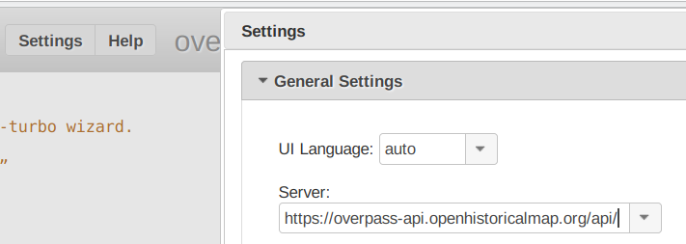
Set the server to use OHM

Slide 14
JOSM

